Slide 1
Microsoft Azure Workshop
Presenters: Amanda Wong, Jason Xiao
Azure AI & Analytics Team
September 12, 2020

Slide 2

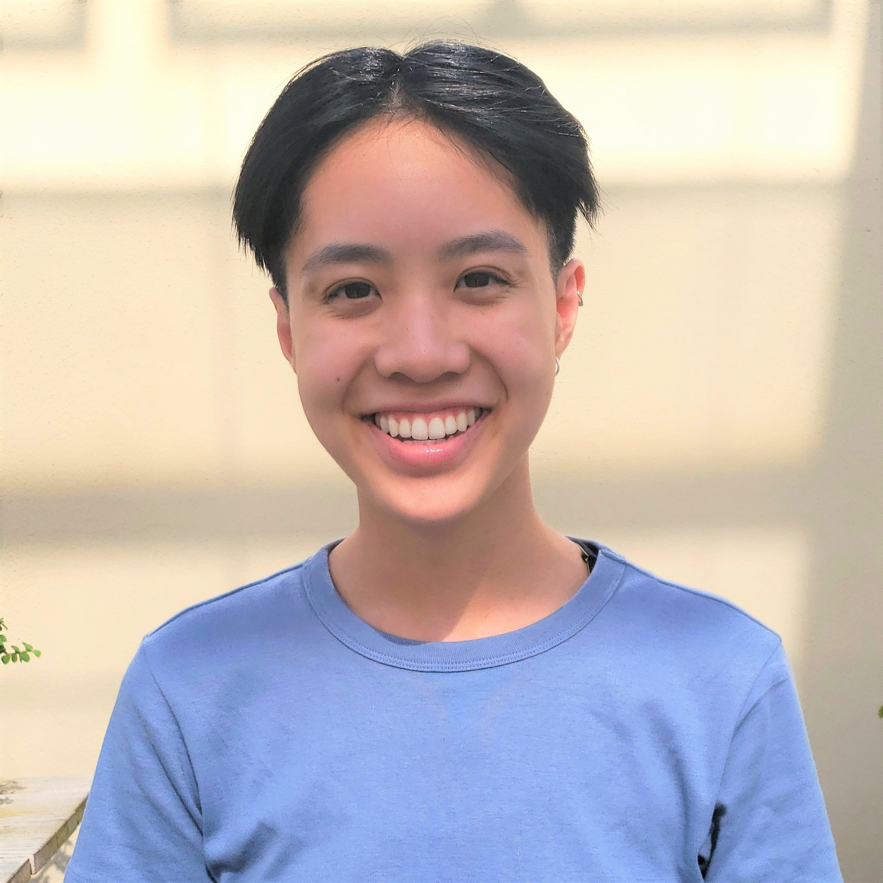
Jason Xiao
Cloud Solution Architect
UC Berkeley (2020)
Electrical Engineering and Computer Science
jxiao@microsoft.com
Amanda Wong Cloud Solution Architect
University of Chicago (2020)
Statistics, Art History
amawong@microsoft.com

Slide 3
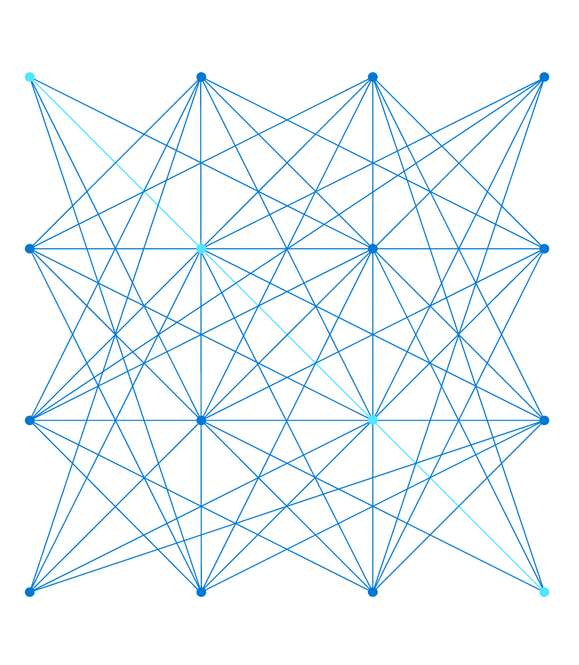
What is an API?
An Application Program Interface (API) is a set of routines, protocols, and tools for building software applications (Source)
Simply put: an interface to talk to other software
GET request retrieves data from a specified resource in a server via an endpoint
POST request sends data to the API server to make changes to a resource
Notes:
2 systems talking to each other -> ask system 1 for information via POSTMAN or requests, where endpoint is a web browser if using a REST API (from Portal)
Analogy (APIs and SDKs)
At a restaurant, they bring you a menu. The food is in the kitchen, which is the application. We are the other application. To get the food you want, you have to send a request thru the protocol (waiter) thru the endpoint (the line on the menu, e.g., “OCR” in computer vision API). They bring you the food back.
With the SDK, they bring you more with your food and the menu is the same
Note: we will give them a public key in case theirs doesn’t work
POST request example: online contact form - when you submit a contact form, your response is put in the “response body” of the request sent to the server.

Slide 4
Azure Cognitive Services
A comprehensive family of AI services and cognitive APIs to help you build intelligent apps
Services include:
Text Analytics (what we’re covering today!)
LUIS
Speech-to-text
Cognitive search
Decision making
Notes:
A collection of Azure-based ML/AI APIs that can hear, speak, search, see, understand and potentially accelerate decision-making into applications.
Show them the webpage and show them how to call it with code -> analysis
Can show the Custom Vision API link that Anthony shared bc it’s straightforward

Slide 5
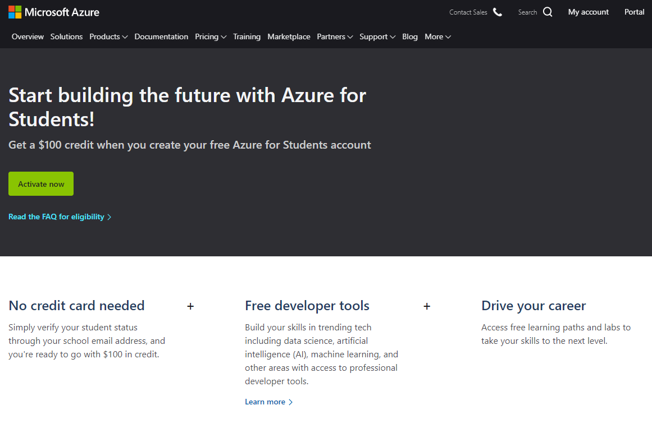
Demo! – Creating an Azure Cognitive Services Resource
Azure Student Subscription https://azure.microsoft.com/en-us/free/students/
Azure Portal https://portal.azure.com/

Slide 6
Pre-requisites for today
Requests library
pip install --upgrade requests
Jupyter Notebooks/IDE
Git

Slide 7
Demo! - Using the Text Analytics API
GitHub starter repository link
http://bit.ly/berkeley-azure
How to use keys and endpoints
https://docs.microsoft.com/en-us/azure/cognitive-services/text-analytics/quickstarts/python
Python API access to text analytics

